Slide 1
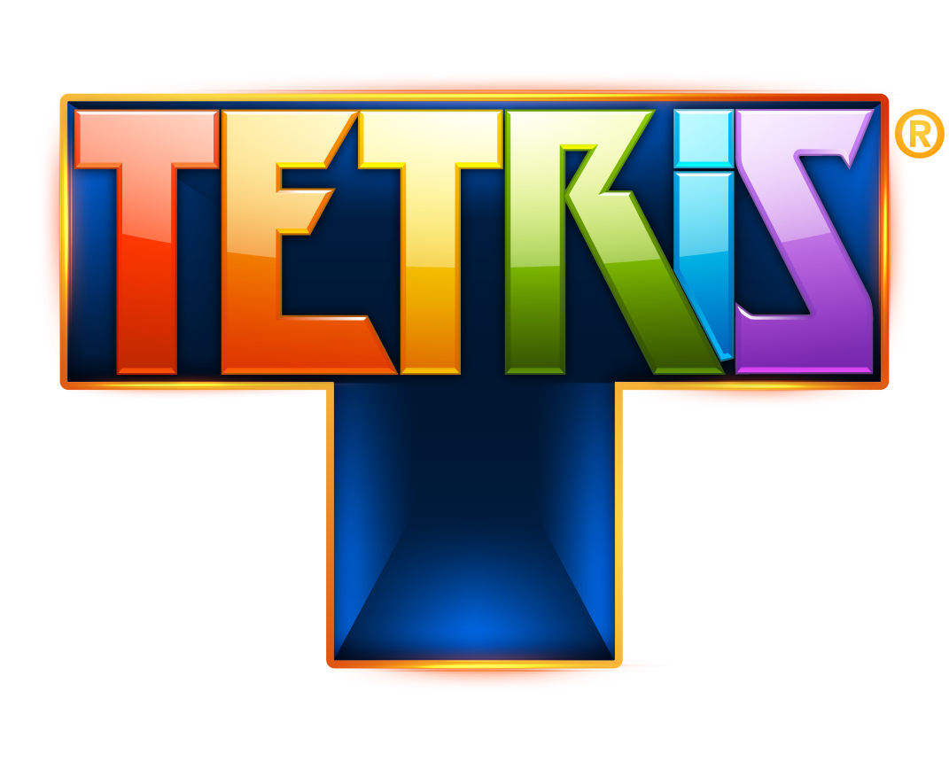
By:
Senanu Adjabeng

Slide 2

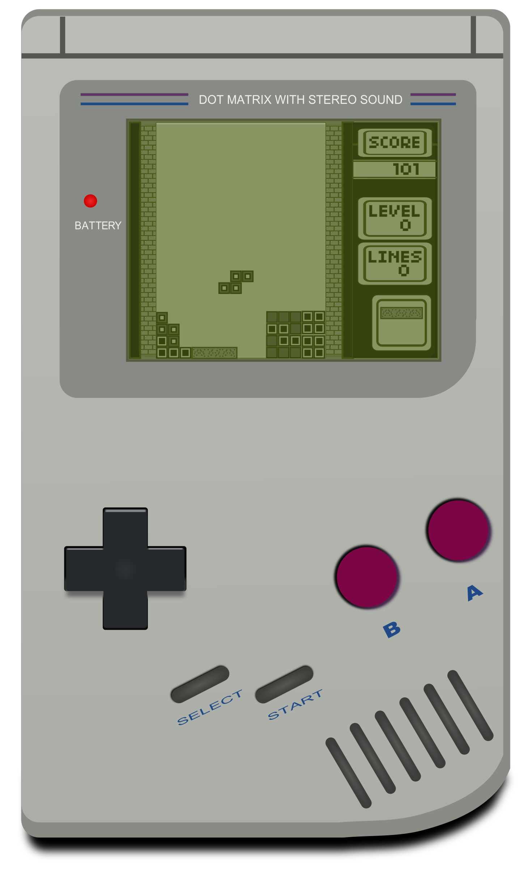
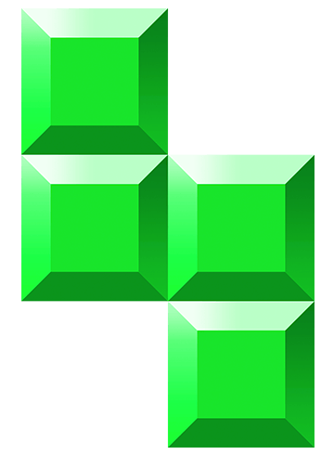
Content
Features
Class Hierarchy
Demo

Slide 3
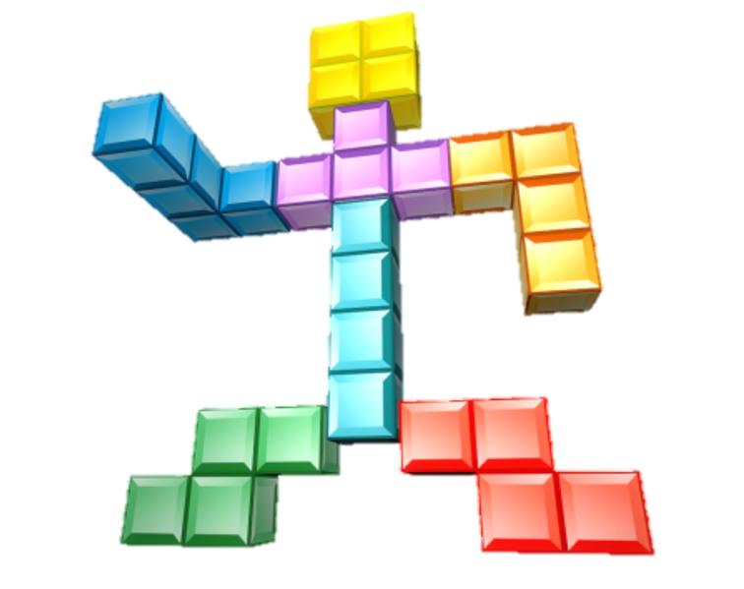
Features
Tetris is a classic game in which different shapes, made up of blocks, descend from the top of the screen. The goal is to create horizontal lines of blocks across the screen with no empty spaces!
Once filled, lines are removed, and points are earned.
Display of the next piece.
Increasing game speed as the score increases.
The game ends when the game has no more room to drop Tetris pieces!

Slide 4
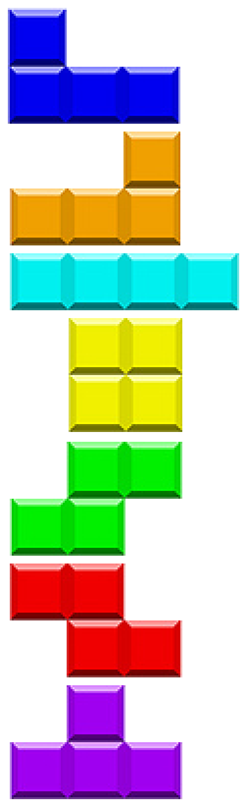
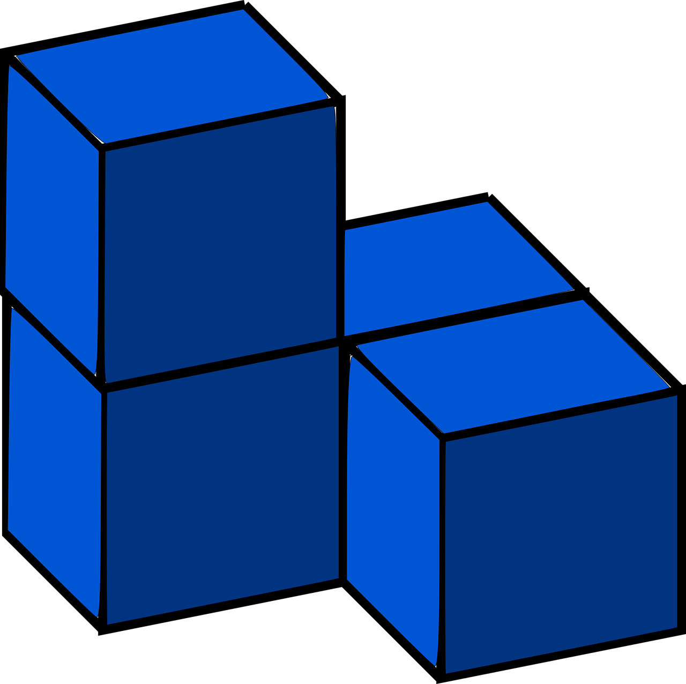
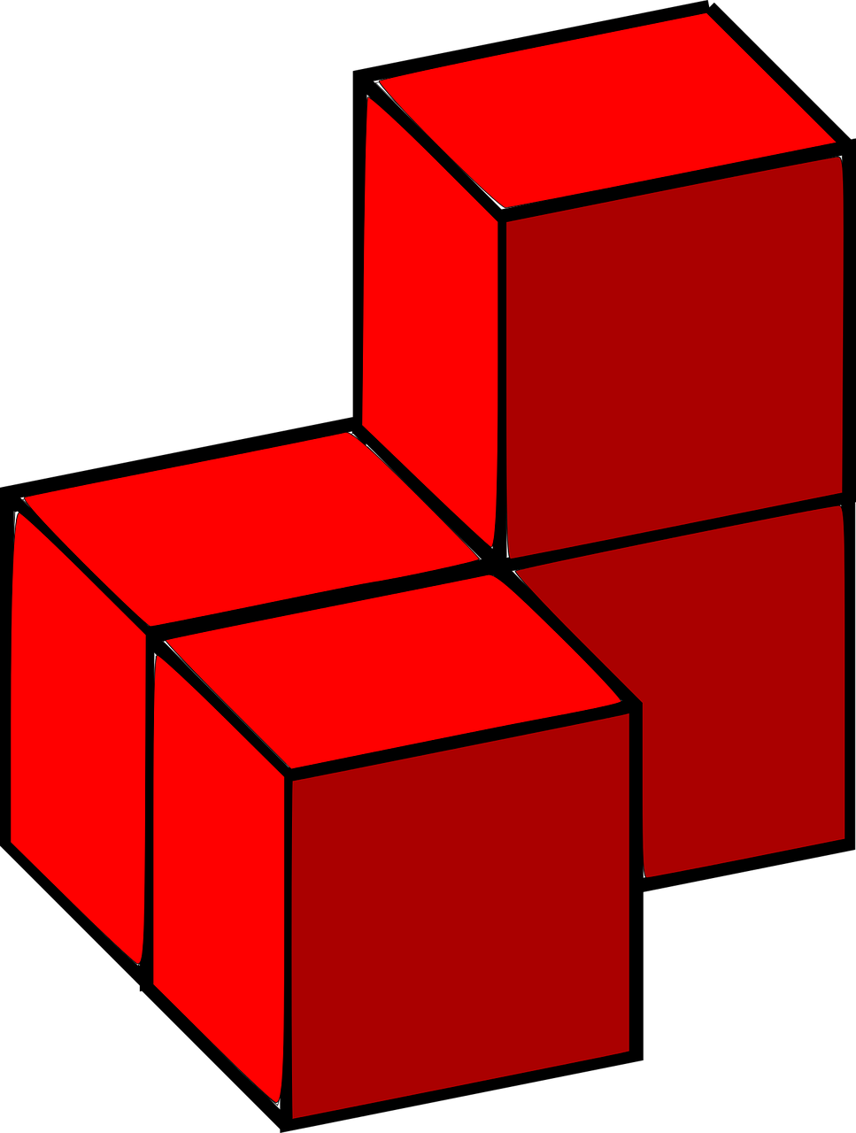
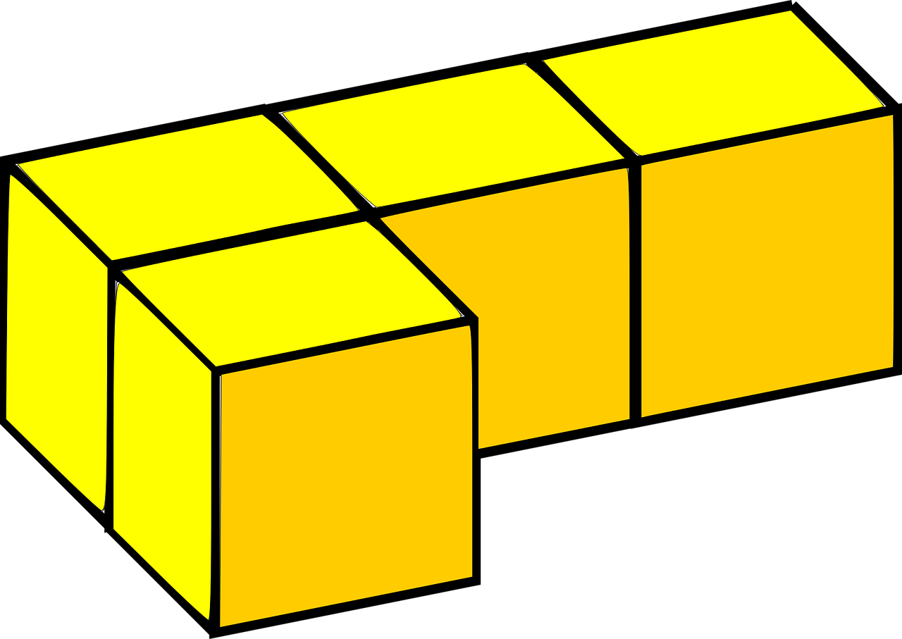
Class Hierarchy
Piece Class: Creates the 90-degree clockwise rotation
Grid Class: Manages the grid operation: drawing the grid, collision, clears the grid
Tetris Game Class: Manages overall game state by inheriting other class properties. i.e., Control movement, starting and pausing the game.

Slide 5
Demo Time
https://senalniho.github.io/My-First-Game/

Slide 6
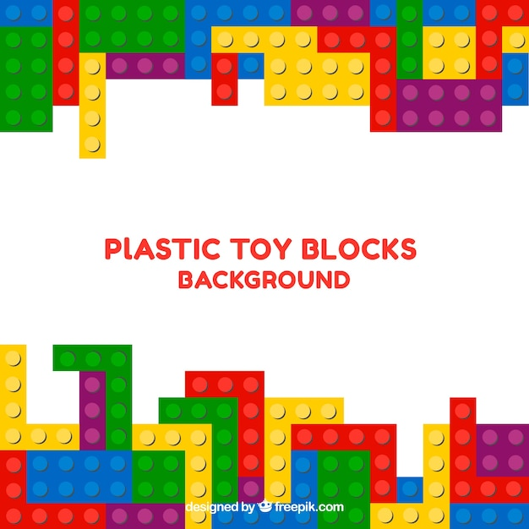
THANK YOU

